Slide 1

Bad prediction

Slide 2

Bad prediction

Slide 3

Bad prediction

Slide 4


Slide 5


Slide 6


Slide 7


Slide 8
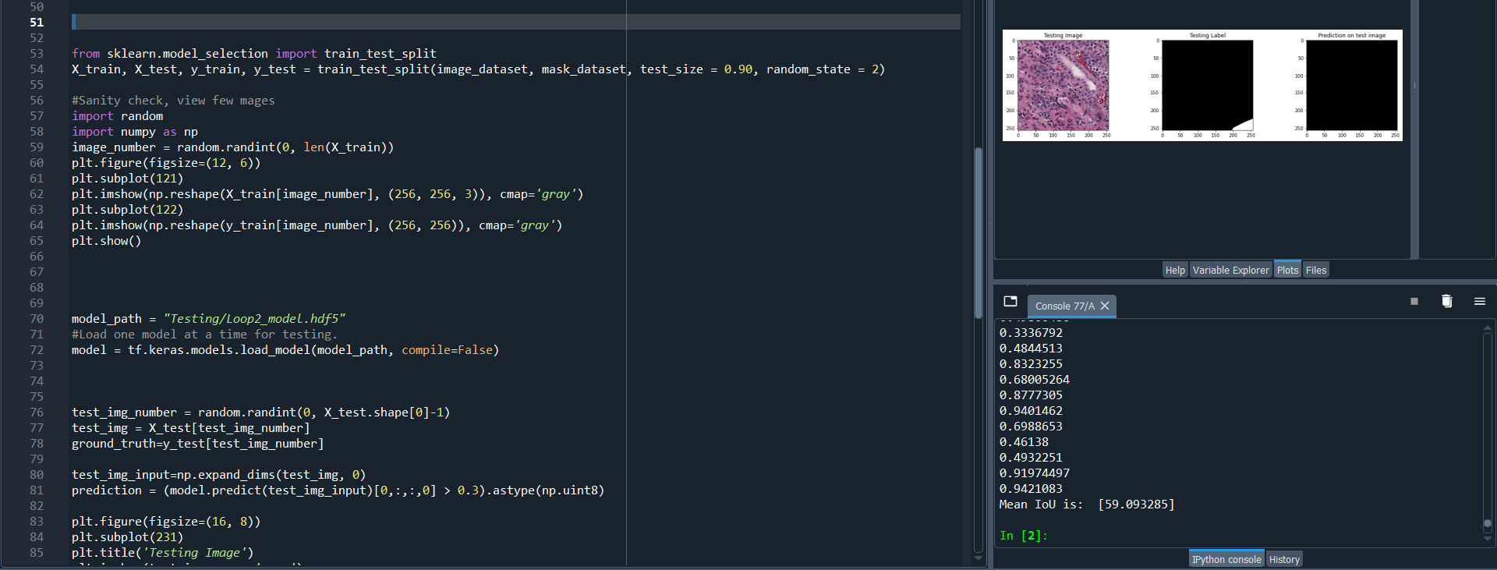

Slide 9


Slide 10
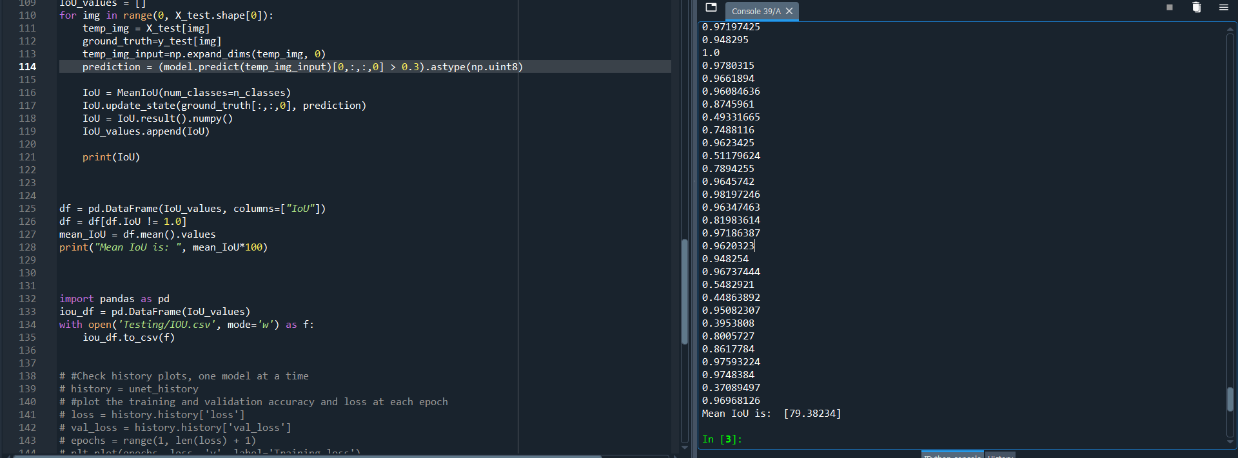

Slide 11
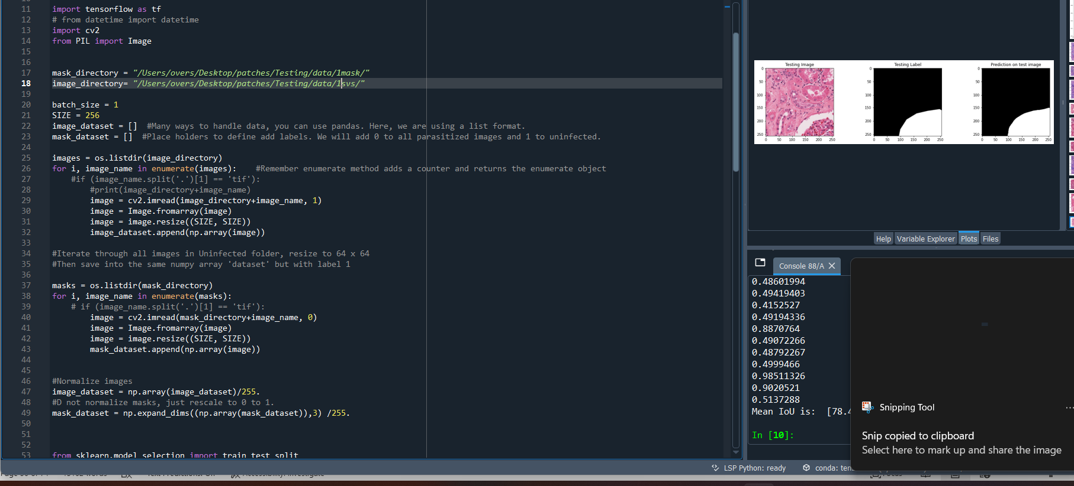

Slide 12
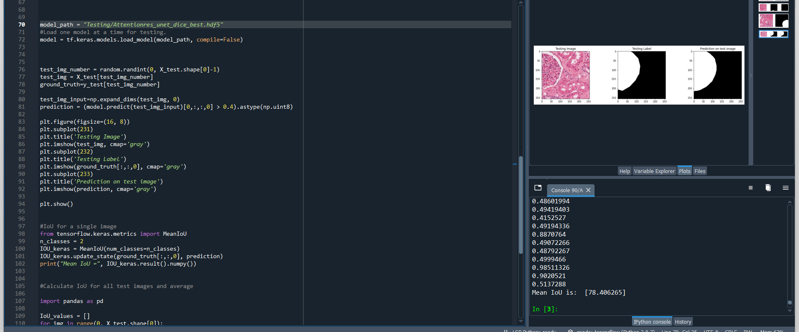

Slide 13

Missed pixels by hand drawing
Correction by network

Slide 14
